Slide 1
Magic Sky
Sky Replacement
Group
3
Reporter：Hive Yuan
Mentor：Jia Yan

Slide 2
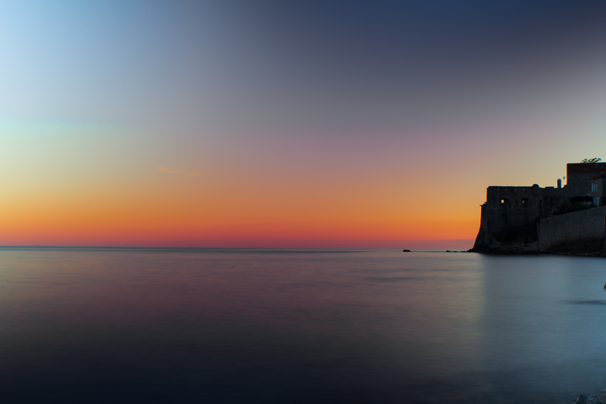
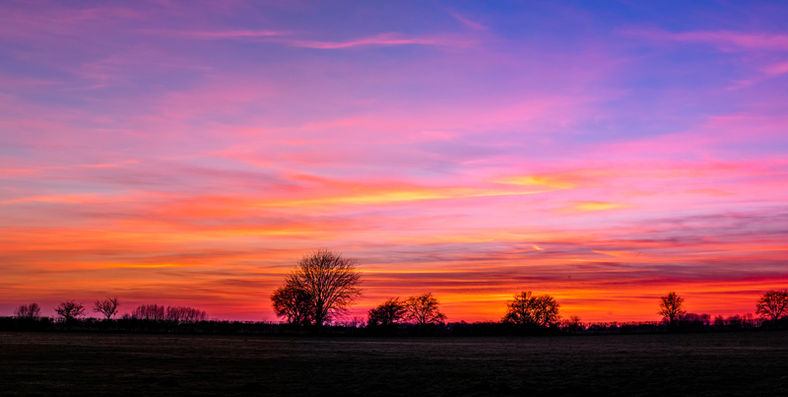
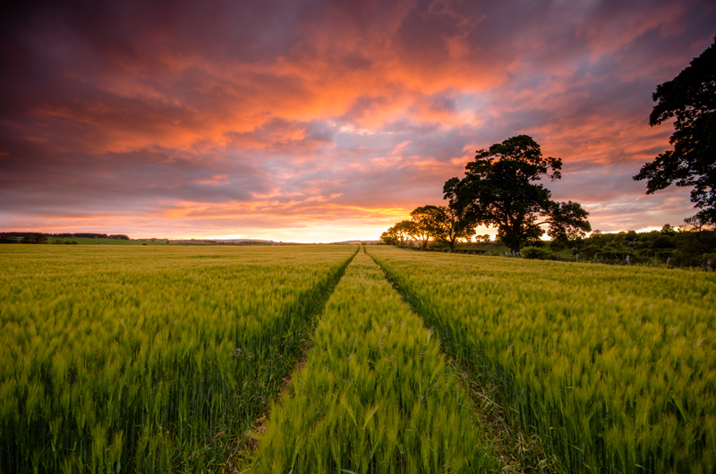
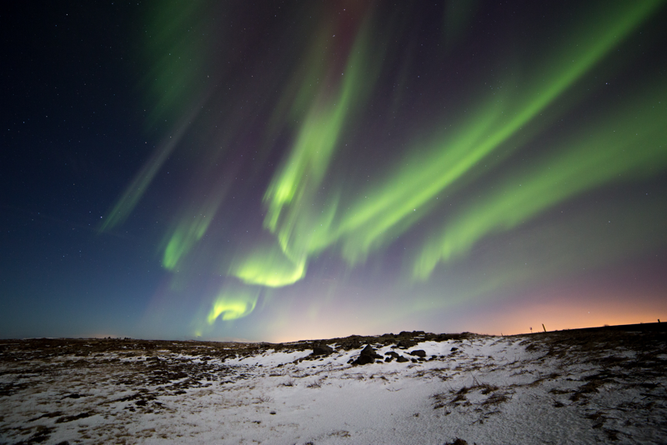
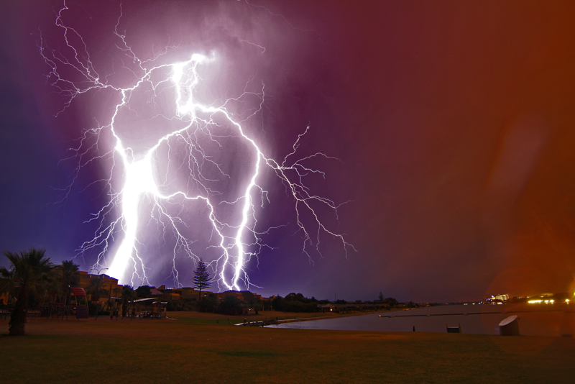
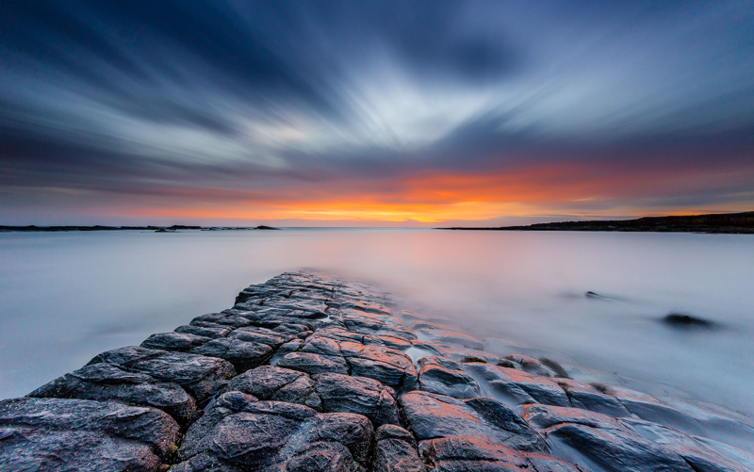
dreaming about being a photographer？

Slide 3
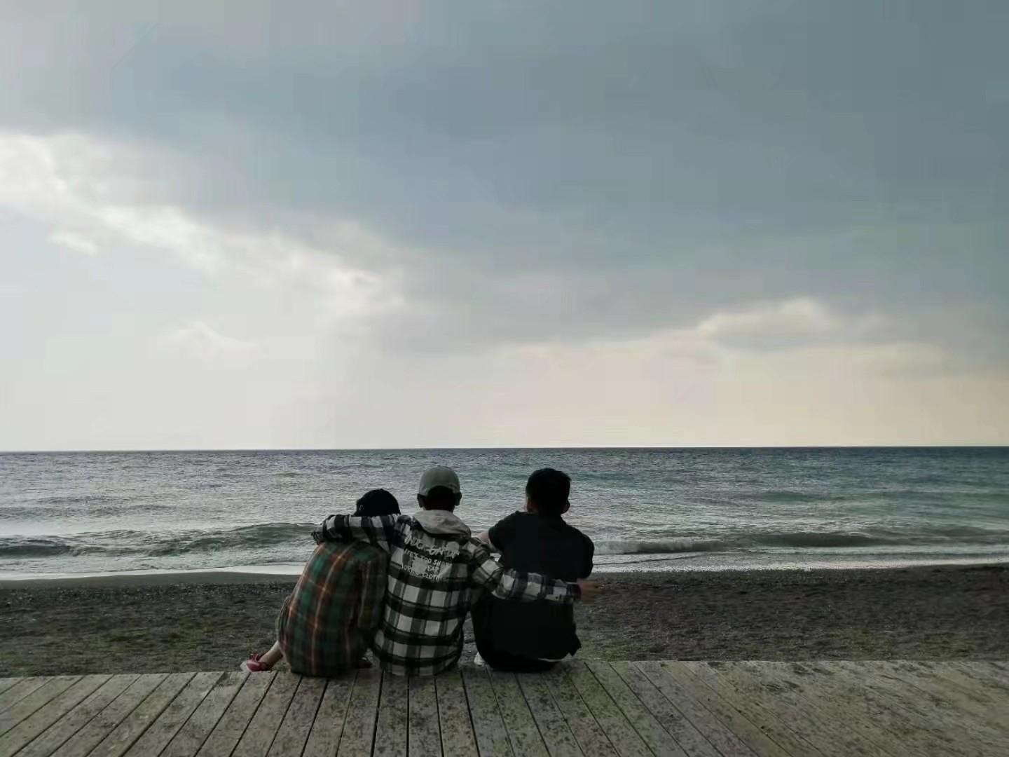
ugly sky!!!
A perfect scene
A bad sky

Slide 4

step
1
I want to replace this stupid sky

Slide 5
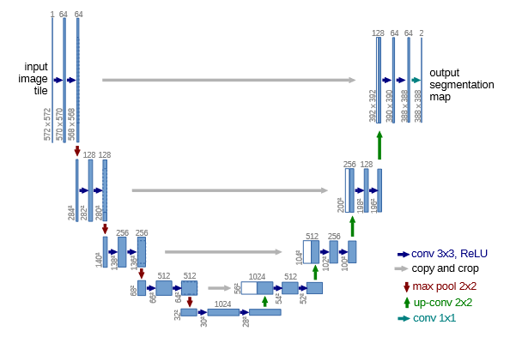

01
U-Net——getting sky mask
Ronneberger O , Fischer P , Brox T . U-Net: Convolutional Networks for Biomedical Image Segmentation[J]. 2015.

Slide 6



01
U-Net——getting sky mask
ADE20K 903 images
U-Net
model
trained for 200 epochs
get the sky mask
[1]Scene Parsing through ADE20K Dataset. Bolei Zhou, Hang Zhao, Xavier Puig, Sanja Fidler, Adela Barriuso and Antonio Torralba. Computer Vision and Pattern Recognition (CVPR), 2017.
binarize the output

Slide 7
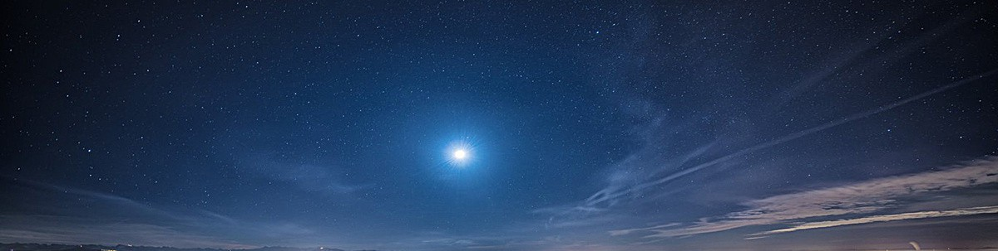
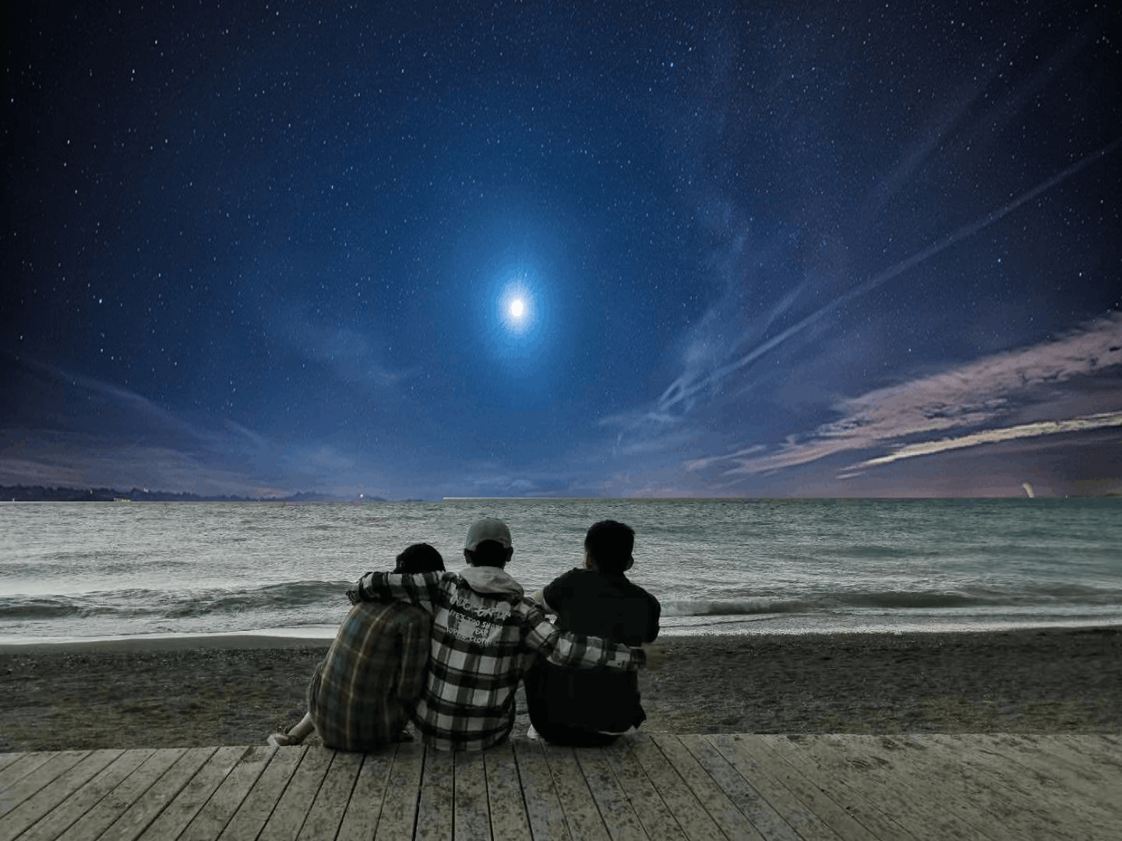

01
U-Net——getting sky mask
01
&
resize
&

Slide 8
Dark sky ?
bright beach ? ?

Slide 9
step
2
we need to transfer the color

Slide 10
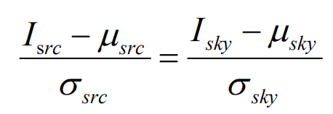
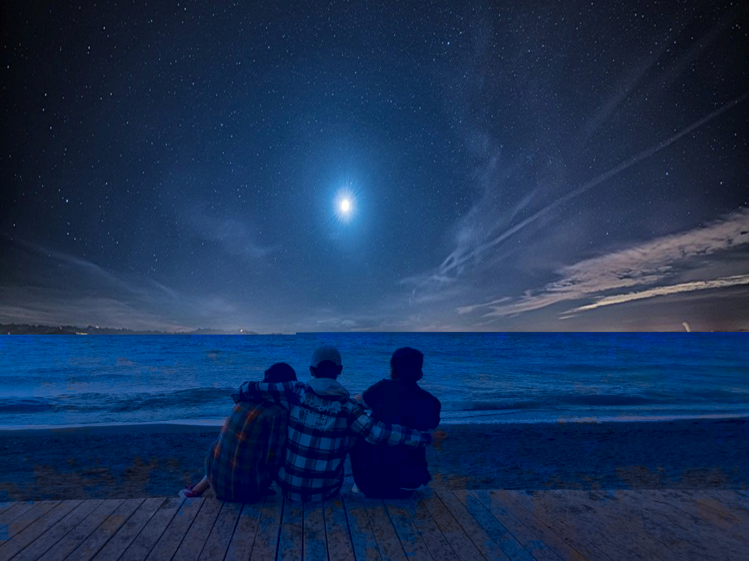
02
color transfer
01
maps the histogram from one image onto another image
What a bad color transfer !!
E. Reinhard, M. Adhikhmin, B. Gooch and P. Shirley, "Color transfer between images," in IEEE Computer Graphics and Applications, vol. 21, no. 5, pp. 34-41, July-Aug. 2001, doi: 10.1109/38.946629.

Slide 11
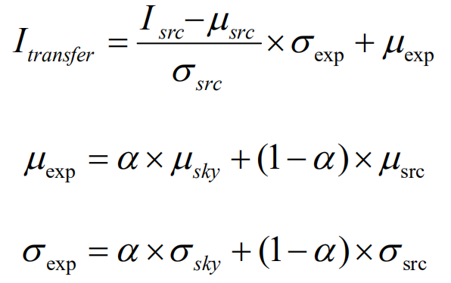
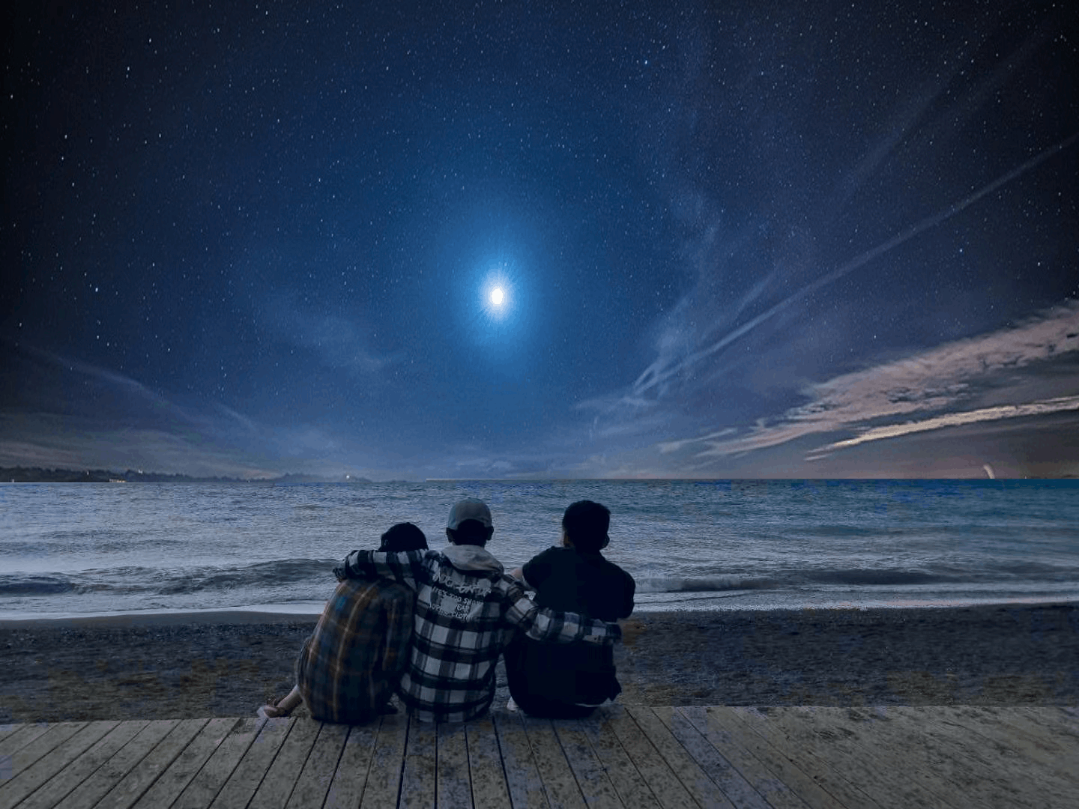
02
improved color transfer
01
much better ^_^

Slide 12
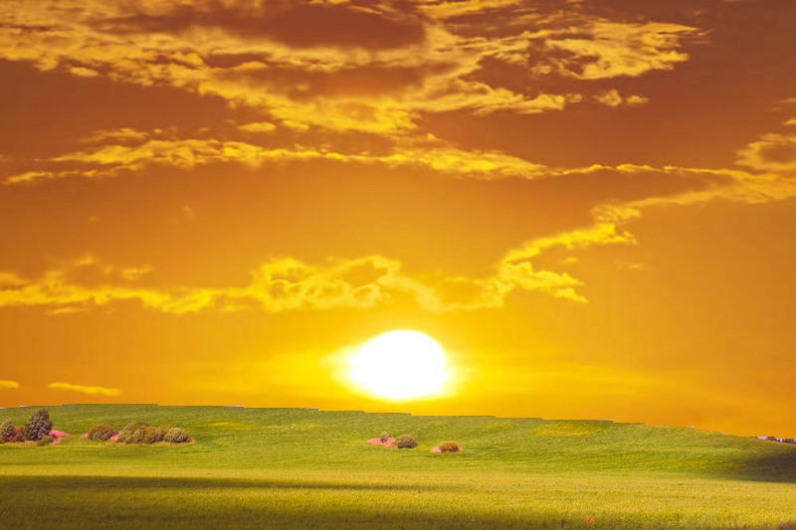
zigzag edge!!
Is that really ok ?

Slide 13
step
3
I don't want zigzag edges！

Slide 14
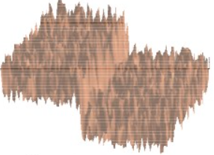
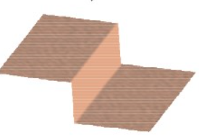

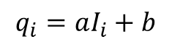
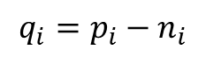
03
guided filter——smooth the edge
$$q_{i}=p_{i}−n_{i}$$
preserve the edge well
while filtering
Filtering input p
Filtering output q
$$q_{i}=aI_{i}+b$$
Guide I
[5]He K , Sun J , Tang X . Guided Image Filtering[J]. IEEE Transactions on Software Engineering, 2013, 35(6):1397-1409.

Slide 15


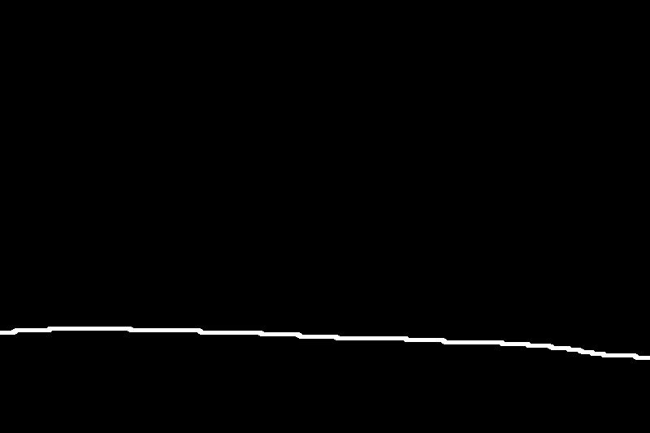
03
guided filter——smooth the edge
do we need to blur the whole image ?
1 | 1 | 1 | 1 | 1
1 | 1 | 1 | 1 | 1
1 | 1 | 1 | 1 | 1
1 | 1 | 1 | 1 | 1
1 | 1 | 1 | 1 | 1
sky mask
canny
dilated

Slide 16
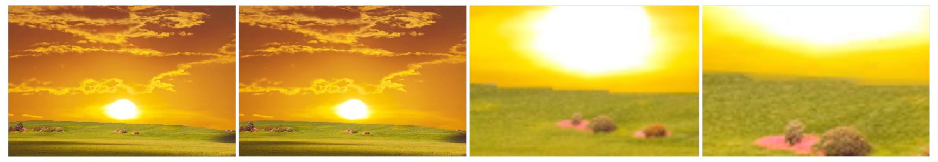
It's ok now o(*￣︶￣*)o
before
filtered
zigzag
smooth edge

Slide 17
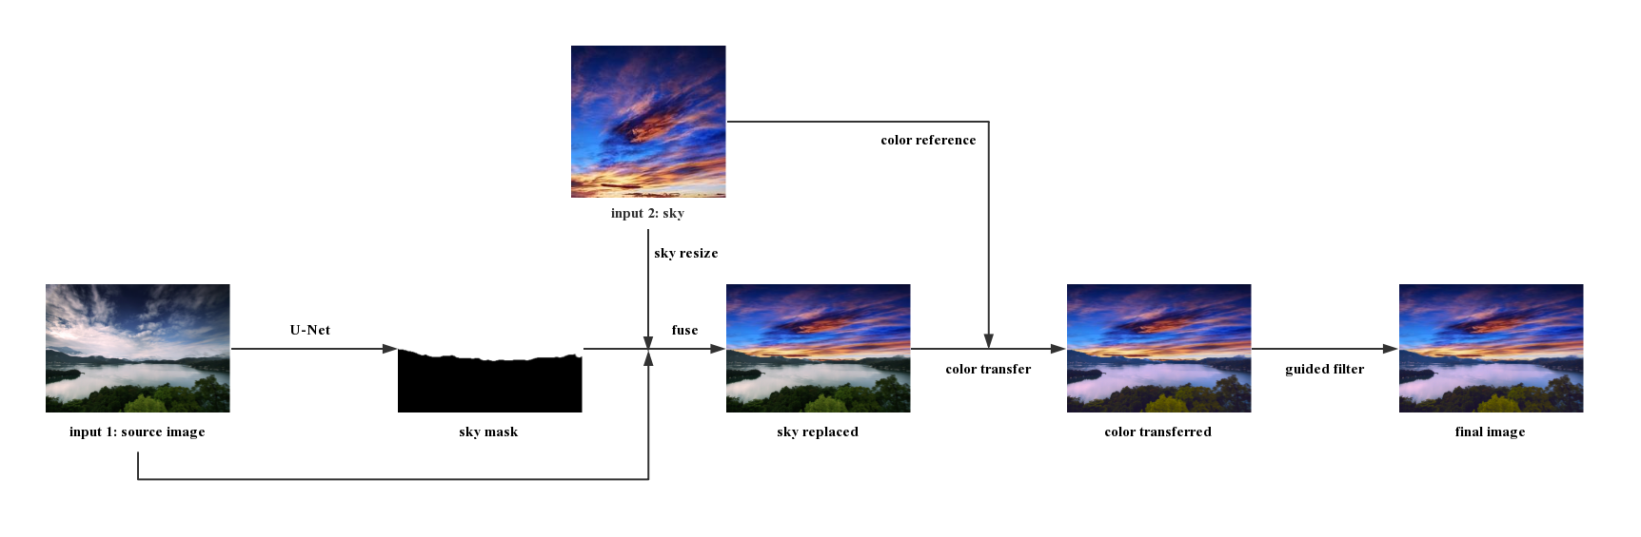
02
Let's check what we have done!

Slide 18
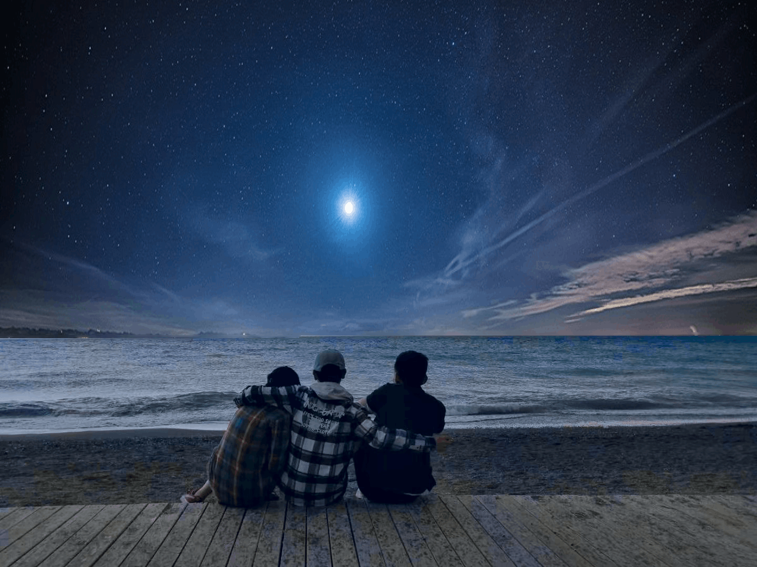
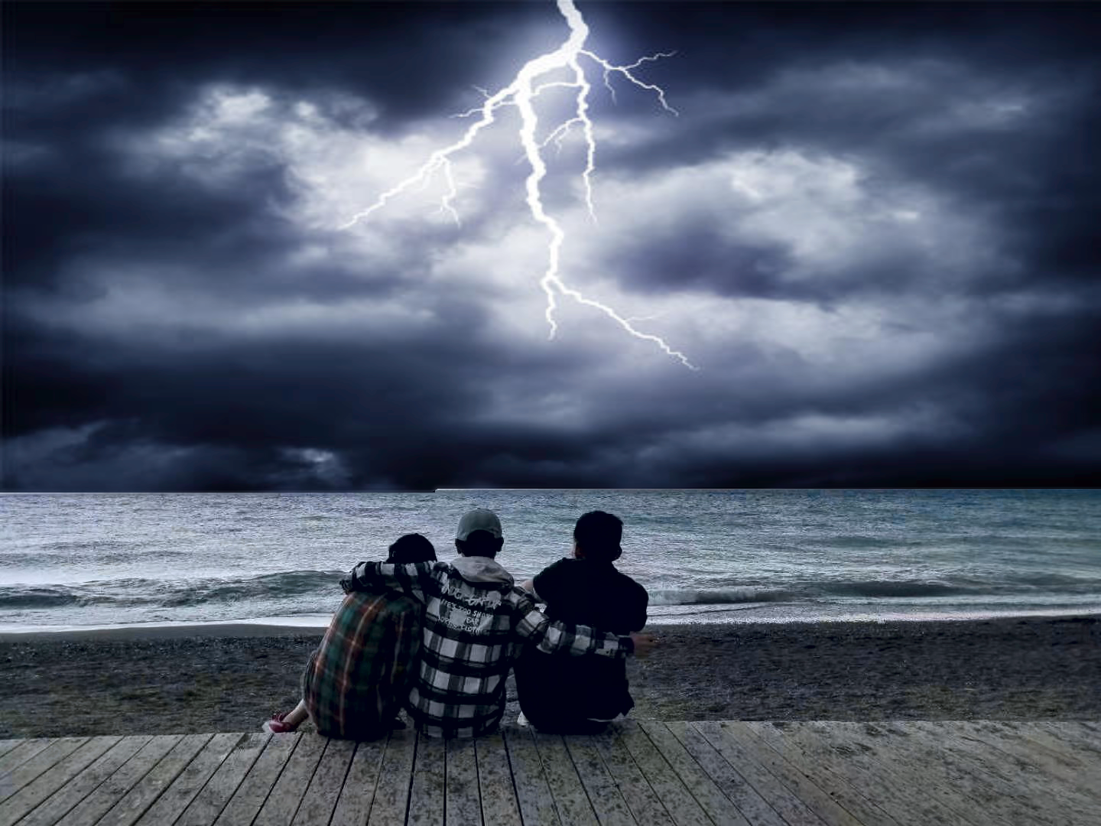
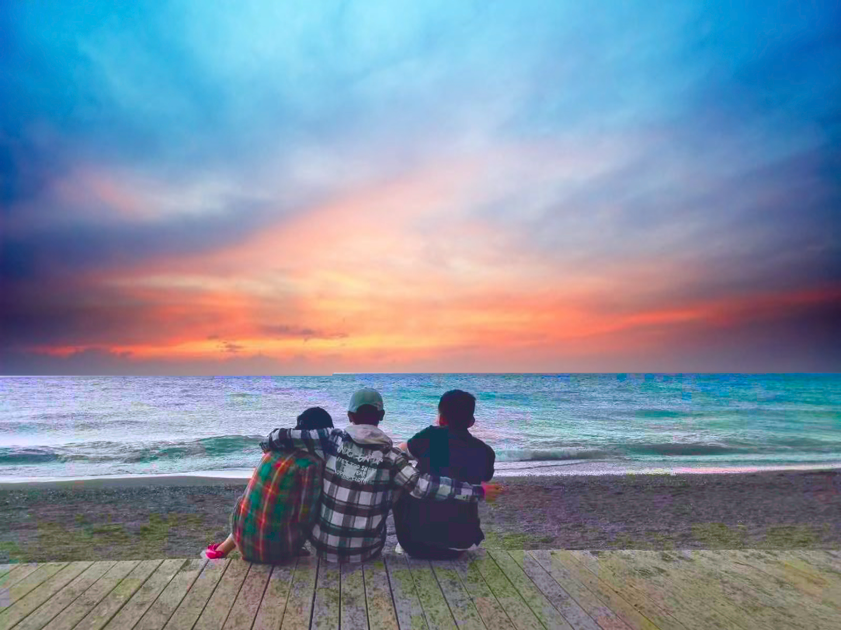
You won't be alone
at nights.
Don't be afraid.
I'll be with you.
The future is
waiting for us.
We're not changing the sky. We're changing the emotions the image conveys.
We are
photographers.
magicians.

Slide 19
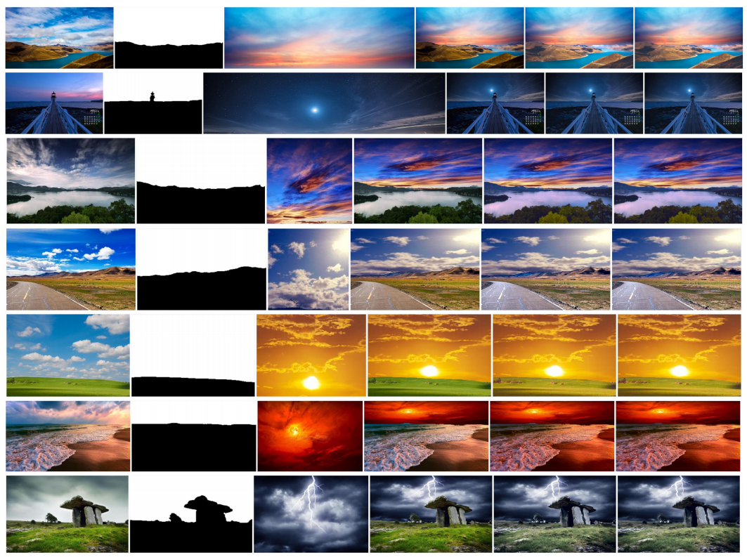

Do you think that's all ?
02
n a i v e

Slide 20
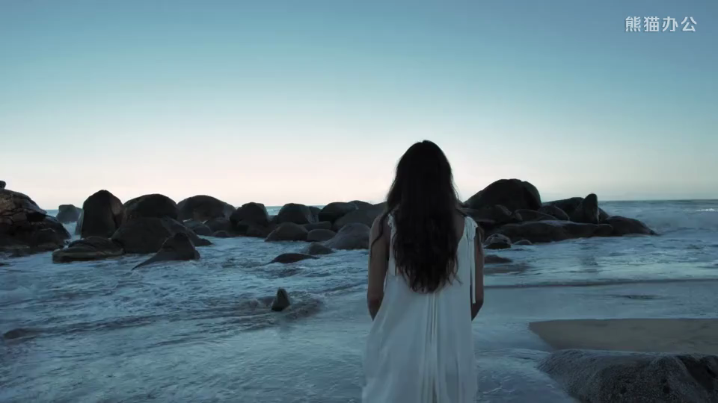
step
4
video processing

Slide 21
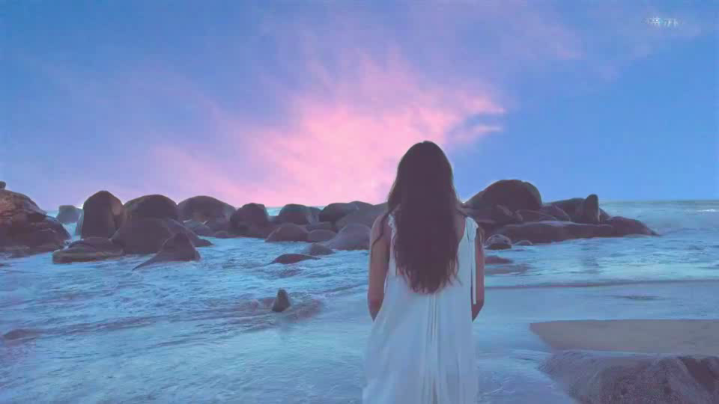
step
4
video processing

Slide 22
04
video processing
 | Mask getting (s) | Sky replace (s) | Color transfer (s) | Guided filter (s) | Total (s)
Before optimizing | 0.22 | 1.02 | 2.37 | 2.63 | 6.24
Optimized | 0.218 | 0.044 | 0.074 | 0.246 | 0.582

Slide 23
04
Demonstration

Slide 24
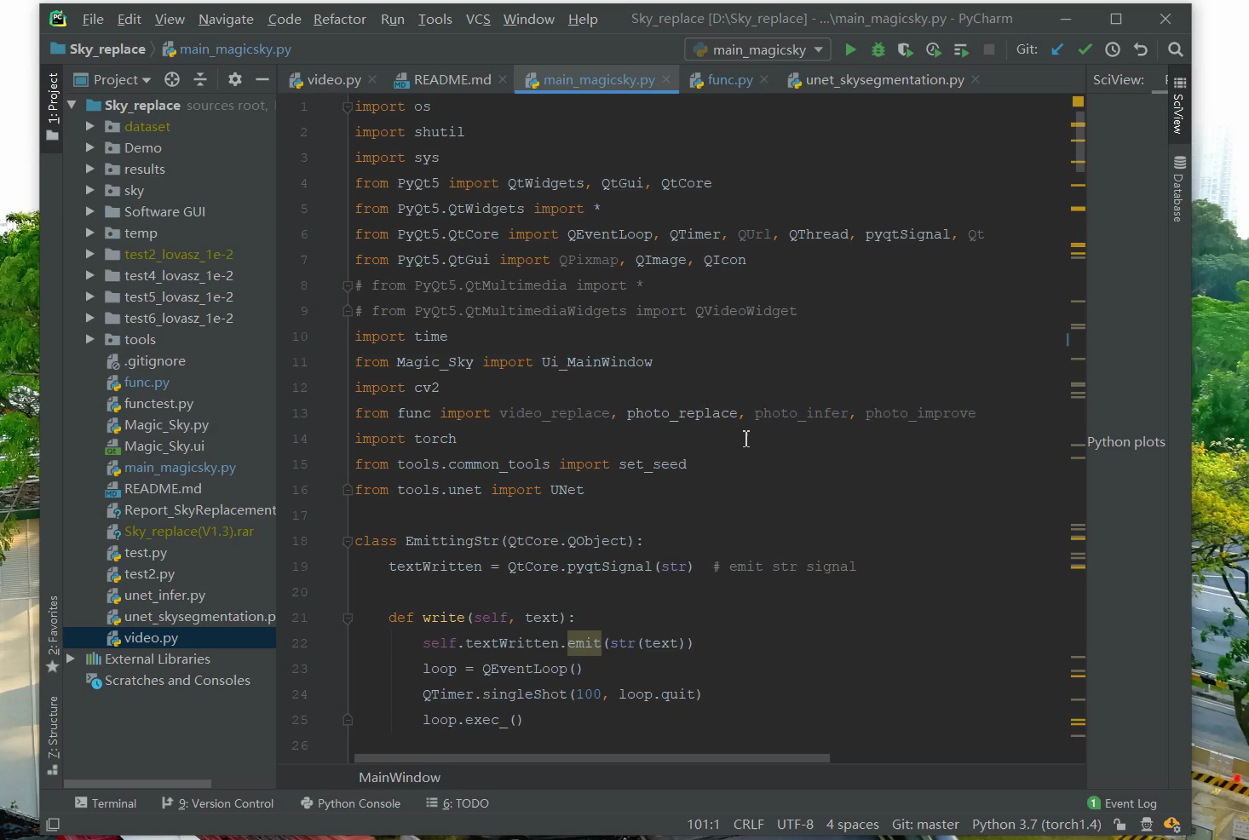
04
Demonstration

Slide 25
05
Writing at last

Slide 26
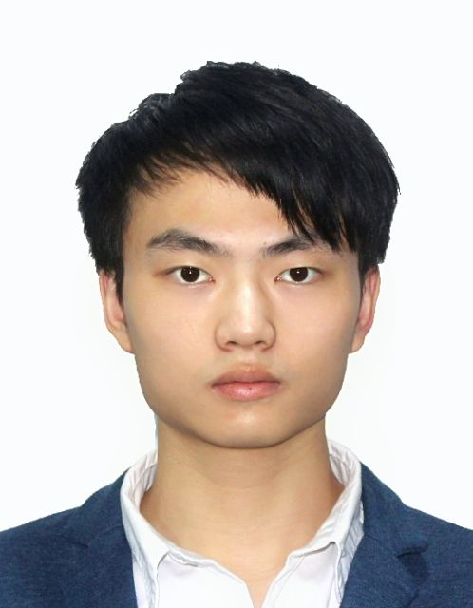
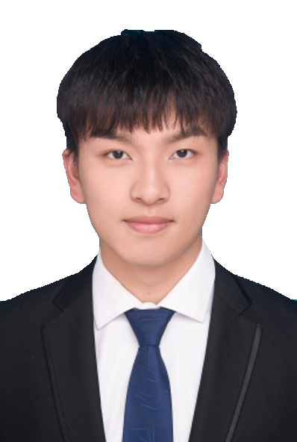
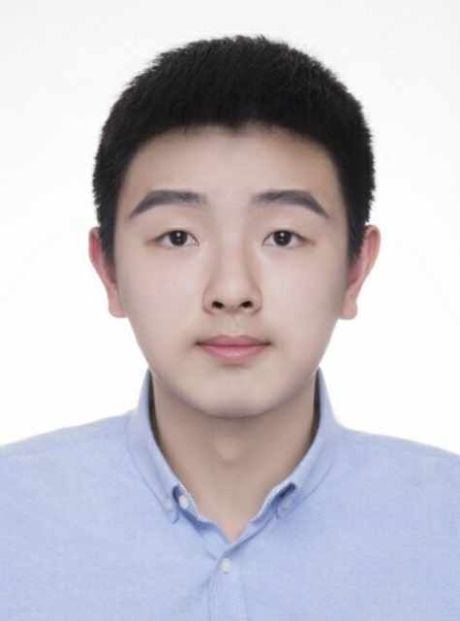
05
Conclusion
Authors’ Contribution
Jing Wu
Hive Yuan
Zhao Shen
network configuration
GUI coding
algorithm optimization
color transfer
guided filter
writing report
making PPT, presentation
dataset labelling
writing report
making PPT

Slide 27
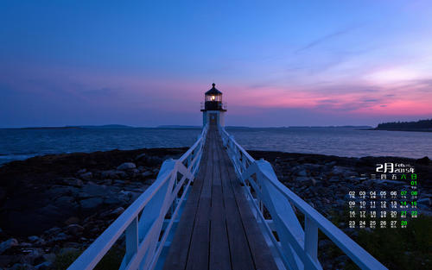
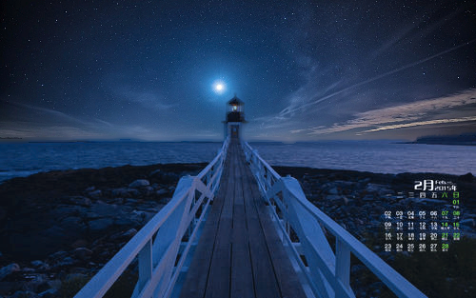
Magic Sky
Sky Replacement
thank you~
Members：Jing Wu
Hive Yuan
Zhao shen
Mentor：Jia Yan

